Slide 1
in this Section, we will discuss:
PROTOCOLS( FTP & SMTP).
DNS SERVICES.
NETWORK TOPOLOGY.
OSI MODELS.

Slide 2
PROTOCOLS
FTP & SMTP

Slide 3
FTP
FTP stands for FILE TRANSFER PROTOCOL.
It is an Application layer protocol.
It is used to exchange files from one host to another host connected over the internet.
FTP is used to copy files from one host to another browser and the web server.
FTP Server you can Download & upload Files over the Internet.
FTP is the client Server based Model.

Slide 4
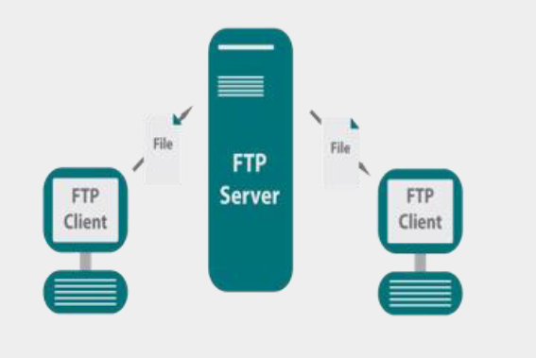

Slide 5
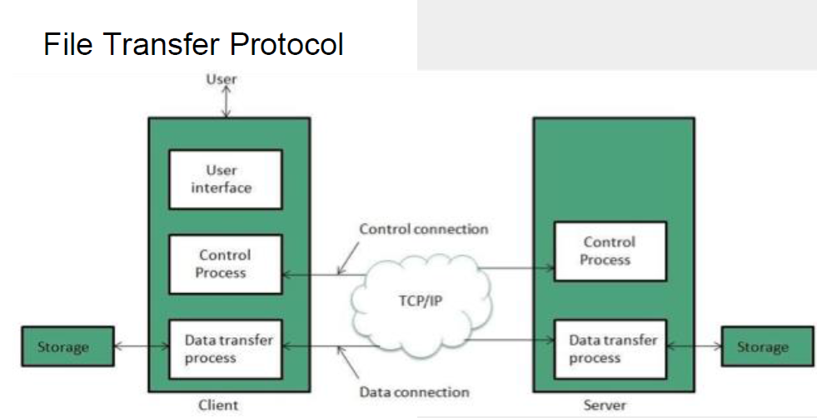

Slide 6
FTP creates two processes such as Control process and Data process at both ends i.e. at client as well as at server.
FTP established two Different Connections:
Control Connection.
Data Connection.
Control connection made between the control Processes while the data connection is made between the data transfer processes.
FTP uses port 21 for the control connection and port 20 for the data connection.

Slide 7
SFTP
SFTP is stands for Secure File Transfer Protocol.
It is just like as FTP except that it adds a layer of security.
Data is encrypted using secure shell during data transfer.
Authenticate the user and the server port 22.

Slide 8
TFTP
TFTP is stands for Trivial File Transfer Protocol.
It is very simple transfer protocol. It is not used to transfer files over the internet like FTP & SFTP.
It is mainly used for transferring files within a local area network.
It is connectionless Protocol that is uses UDP instead of TCP.
TFTP does not provide any security during data transfer.
It is only use in LAN and not over the internet.

Slide 9
FTP Client
It is basically software that is designed to transfer the data between a system and server in the internet.
This software works when it is installed on your computer.
FTP client software can only be used with the help of the internet.
Some of the commonly used FTP clients are Dreamweaver, Fire FTP and FileZilla..

Slide 10
FTP Server
The computer which uses FTP to transfer data is called the FTP Server.
It stores and shares client data.
It can be considered as the middle layer between the user system and the data.
When you transfer the file using the FTP, it is either uploaded or downloaded to FTP Server.

Slide 11
Types of FTP Server
FTP server is divided into two parts:
Anonymous Server.
Non-Anonymous Server.
Anonymous Server: It is common FTP server that is for all FTP clients. There is no need of password required to access this server. Most FTP clients use it.
Non-Anonymous Server: It is a paid server. There is if user wants to access this server user needs password to access the file.

Slide 12
SMTP
SMTP stands for Simple Mail Transfer Protocol.
According to internet standard SMTP was introduced in 1982.
It is an electronic mail (e-mail) transmission communication Protocol.
It is used to sending email efficiently and reliably over the internet.
It is an application level protocol.
It is connection-oriented protocol.
It is text based Protocol.
It provides a mail exchange between users on the same or different computers.

Slide 13
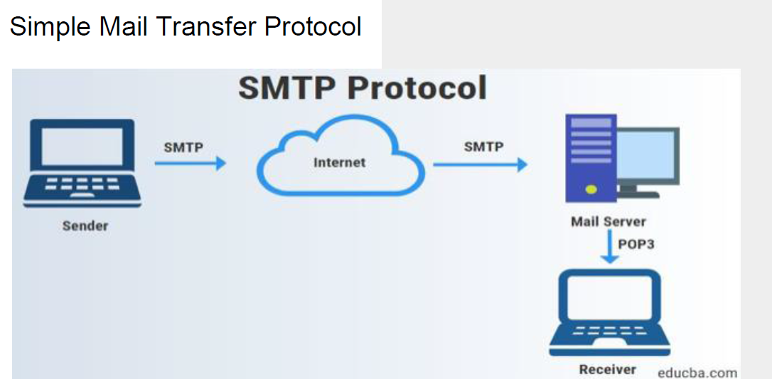

Slide 14
SMTP also supports:
It can send a single message to one or more recipients.
It can also send message on network outside the internet.
It is used to send message include text, video, voice, or graphics.
Example:
SMTP is similar to a mailman. Mailman picks up the mail from your mailbox at your home and then finds the correct route and then delivers it to the destination mailbox.

Slide 15
POP3 & IMAP
POP3
IMAP
POP3 is stands for POST OFFICE PROTOCOLS.
As we know that SMTP is used as a message transfer agent.
When the message is sent, then SMTP is used to deliver the message from the client to the server and then to the recipient server.
It is used to retrieve your email from one devices.
IMAP stands for INTERNET MESSAGE ACCESS PROTOCOL.
It is also used retrieving email but IMAP allows you to view your email.
It is used to retrieve your email from multiple devices.

Slide 16
DNS Services
Domain name system

Slide 17
DNS
DNS stands for Domain Name System. Domain Name System (DNS) is an Internet service that translates the domain names into IP addresses, which computer can understand. Every device connected to the internet has a unique IP address which other machines use to find the device.

Slide 18
DNS Server
There are four types of DNS server:
DNS Recursor- The recursor can be thought of as a librarian who is asked to go to find a particular book somewhere in a Library.
Root Name Server- The root server is the first step in translating (resolving) human readable hast name into IP addresses.
TLD Name Server- The top level Domain Server [TLD] can be thought of as a specific rack books in a library.
Authoritative Name Server- This final name server can be thought of as a dictionary on a rack of books, in which specific name can be translated into its definition.

Slide 20
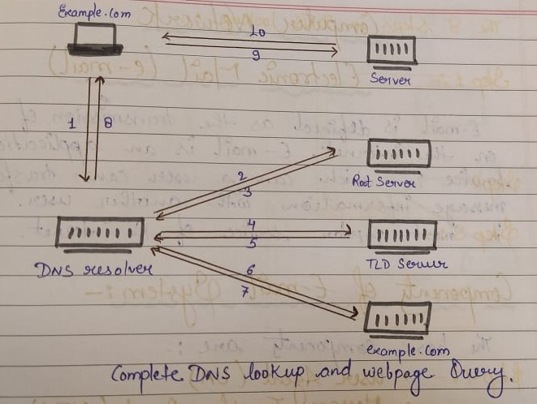

Slide 21
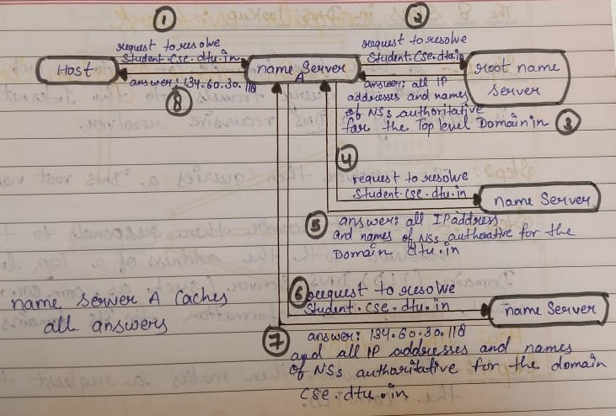

Slide 22
Three types of DNS Queries:
Recursive Query: In a recursive query, a DNS clients requires that a DNS Server will respond to the client with either the requested resource record or an error message if the resolver can't find the record.
Iterative Query: In this situation the DNS Client will allow a DNS Server to return the best answer it can.
Non-recursive Query: A DNS resolver client queries a DNS Server for a record that it has access to either because it's authorative for the record or the record exists inside of its cache.

Slide 23
Network topology

Slide 24
NETWORK TOPOLOGY
A Network Topology is a description of the layout of the topology or area covered by the network. “ IT IS A WAY TO CREATE A NETWORK OR COMPUTER NETWORK.”

Slide 25
Types of Topology :-
Network Topology are six types of basic topologies are as follows :
1. BUS TOPOLOGY
2. STAR TOPOLOGY
3. RING TOPOLOGY
4. MESH TOPOLOGY
5. TREE TOPOLOGY
6. HYBRID TOPOLOGY

Slide 26
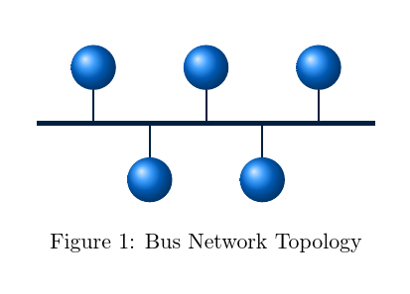
BUS TOPOLOGY
Bus Topology is a specific type of Network topology in which all various devices in the network are connected to a single line cable or line.

Slide 27
Bus Topology
Advantages
Disadvantages
Easy to connect a computer or peripheral to a linear bus.
Requires less cable length than a Star Topology.
Entire network shut down if there is a break in main cable or line.
Difficult to identify the problem if the entire network .

Slide 28
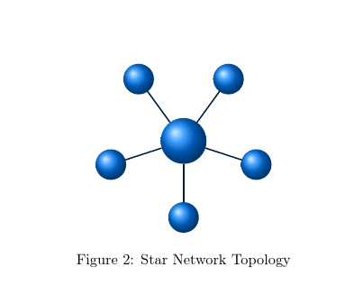
STAR TOPOLOGY
Star Topology is a network topology where each individual piece of a network is attached to a Central node(hub or Switch). Star topology is also known as STAR NETWORK.

Slide 29
Star Topology
Advantages
Disadvantages
Easy to install.
Easy to detect fault.
Safe to use.
No point-to-point connection.
It is very useful topology.
It is very reliable.
Data transmission is faster in a star topology.
Require more cable length .
If the hub or switch fails nodes attached are disable.
It is more expensive.

Slide 30
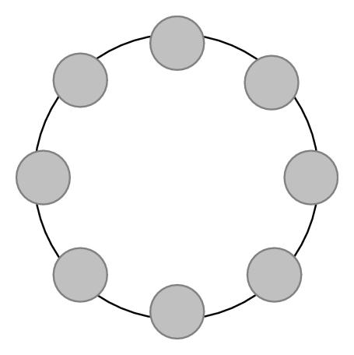
RING TOPOLOGY
It is a specific kind of network setup in which devices are connected in a ring pass information two or from each other computer in the ring structure.
Figure 3: Ring Network Topology

Slide 31
Ring Topology
Advantages
Disadvantages
Point to point line configuration make it easy to identify and isolate fault.
Does not require a central node or hub to manage the communicate between the computers.
Moving adding and changing the device can effect the network.
Bandwidth is shared on all links between the devices.

Slide 32
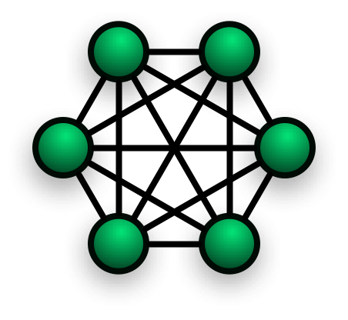
MESH TOPOLOGY
In a Mesh Topology there is no central connection point. Each node is connected to at least one other node and usually to more than one.
Figure 4: Mesh Network Topology

Slide 33
Mesh Topology
Advantages
Disadvantages
Network can be easily expanded.
Send the data from one node to many nodes.
It quite expansive since a higher length of cable required.

Slide 34
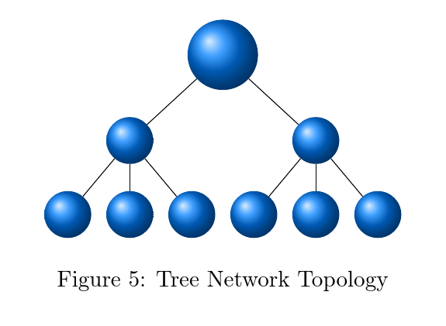
TREE TOPOLOGY
A Tree Topology is a type of network topology that includes at least three specific level in a topology hierarchy . Tree Topology is a Combination of star and bus topology.

Slide 35
Tree Topology
Advantages
Disadvantages
It is the most suitable topology for large network.
Since it divides the network in sub parts so it becomes more manageable.
If the main cable line breaks, the entire segments goes down.
More difficult to configure and wire than other topologies.

Slide 36
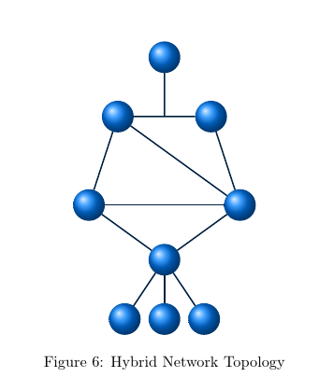
HYBRID TOPOLOGY
A Hybrid Topology is a network topology design contains more than one topology . It is also known as mix topology.
( in figure 6: mixing of three topology Star, Ring & Mesh topology ).

Slide 37
Hybrid Topology
Advantages
Disadvantages
Since it divides the network in sub parts, so it becomes more manageable.
More difficult to configure and wire than other topologies.

Slide 38
Importance of Network Topology
Error or fault detection is made easy using network topologies.
It allows us to understand the different elements of our network and where they connect.
Play a crucial role in performance.
Cost Reduction.

Slide 39
OSI MODEL
Open System Interconnection

Slide 40
OSI MODEL
OSI stands for OPEN SYSTEM INTERCONNECTION. It is designed by ISO(International Standard of Organization or International organization for standardization) in 1970s.
OSI was introduced in 1983 by representatives of the major computer and telecom
companies and was adopted by ISO as an international standard in 1984.
An open system is a set of protocols that allows any two different system to communicate regardless of their underlying architecture.

Slide 41
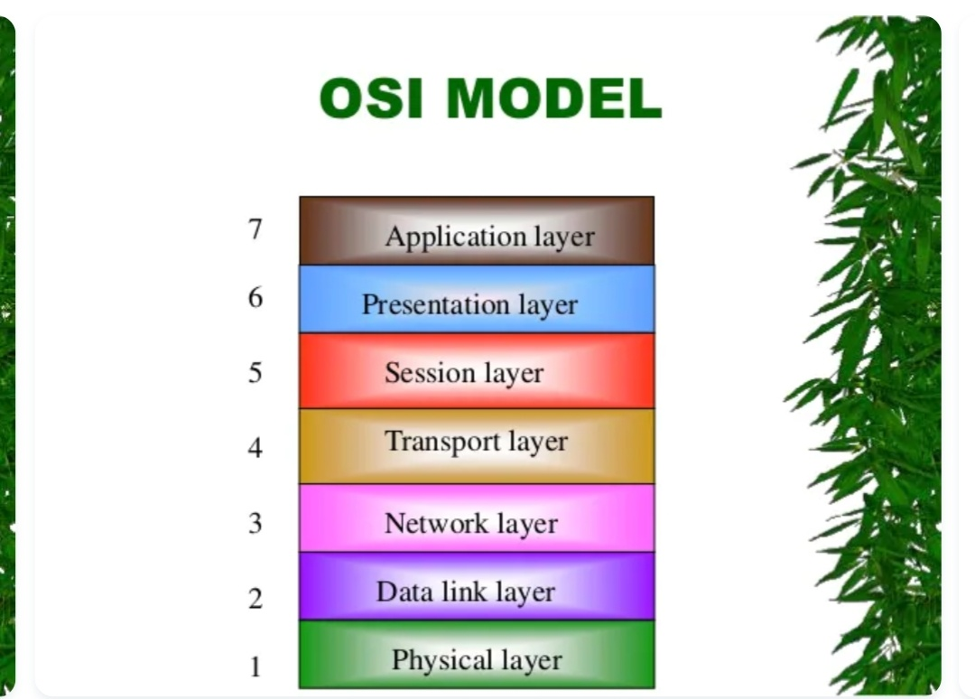
OSI Model

Slide 42
Types of layer
Physical layer
Datalink Layer
Network Layer
Transport layer
Session Layer
Presentation layer
Application Layer

Slide 43
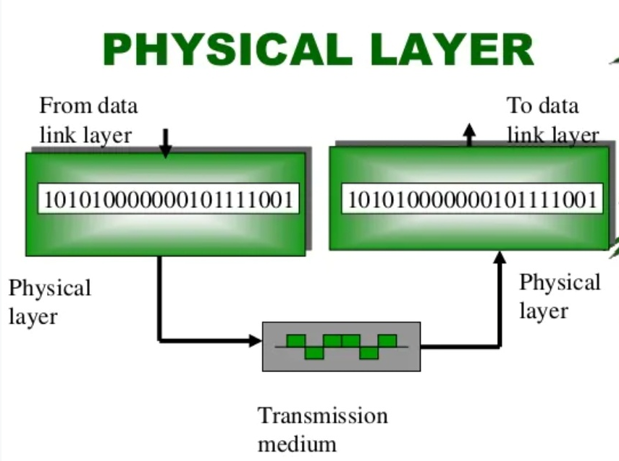
Physical layer
The Physical layer is responsible for transmitting individual bits from one node to the next.
Functions of physical layer:
Representation of bits.
Data Rate.
Synchronization of bits.

Slide 44
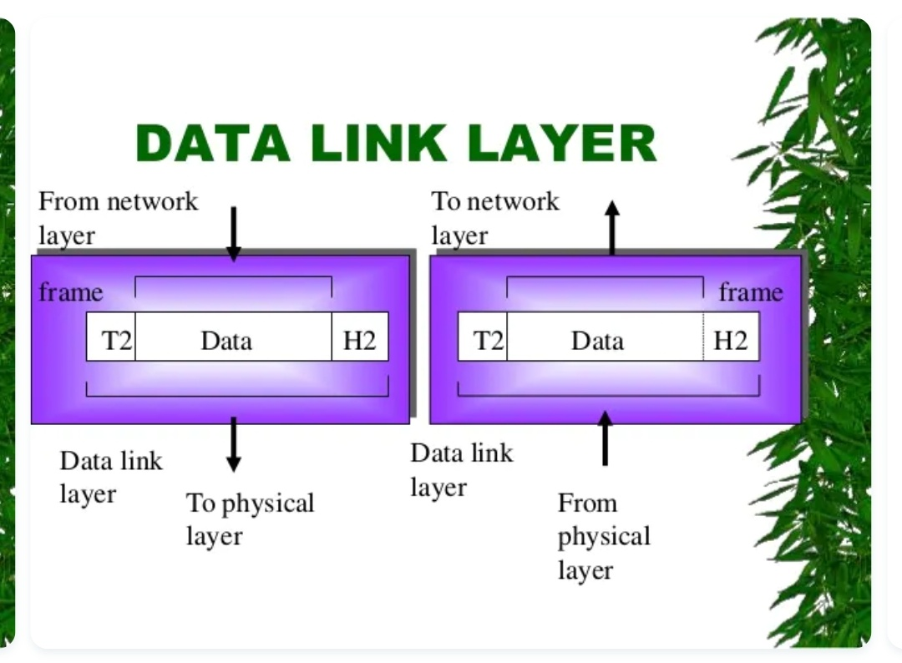
Data link layer
The datalink layer is responsible for transmitting frames from one node to the next.
Functions of Data-link Layer :
Framing
Physical addressing
Flow control
Error control
Access control

Slide 45
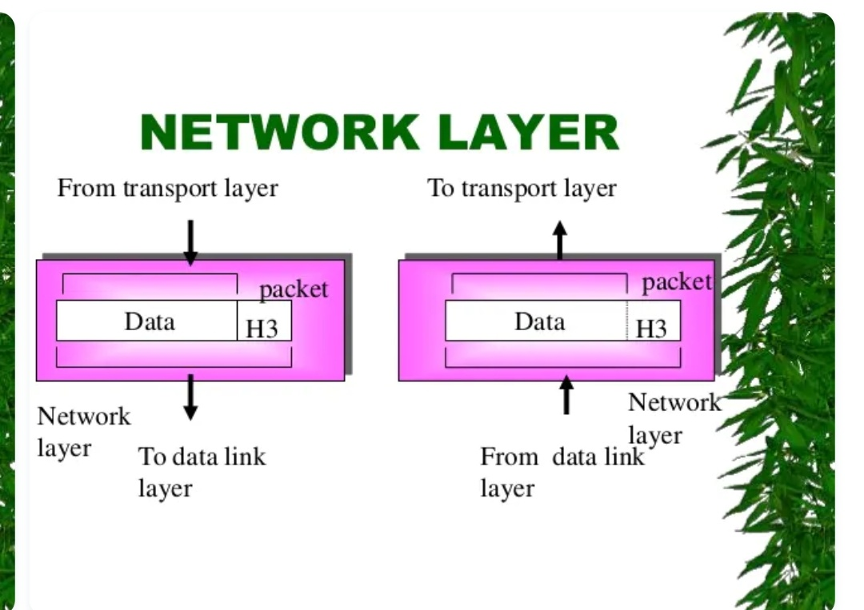
Network layer
The network layer is responsible for the delivery of packets from the original source to the final destination.
Functions of Network Layer:
Local addressing.
Rounting.

Slide 46
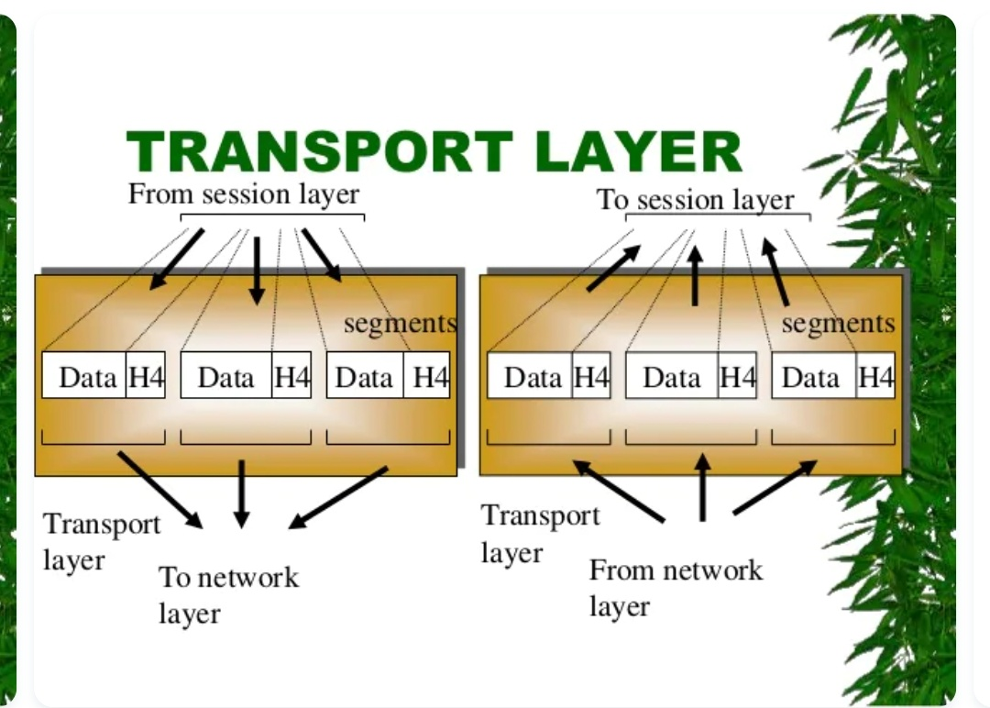
Transport layer
The transport layer is responsible for to delivery of message from one process to another(Process-to-Process delivery).
Functions of Transport layer:
Port Addressing.
Segmentation and reassembly.
Connection control.
Flow & Error control.

Slide 47
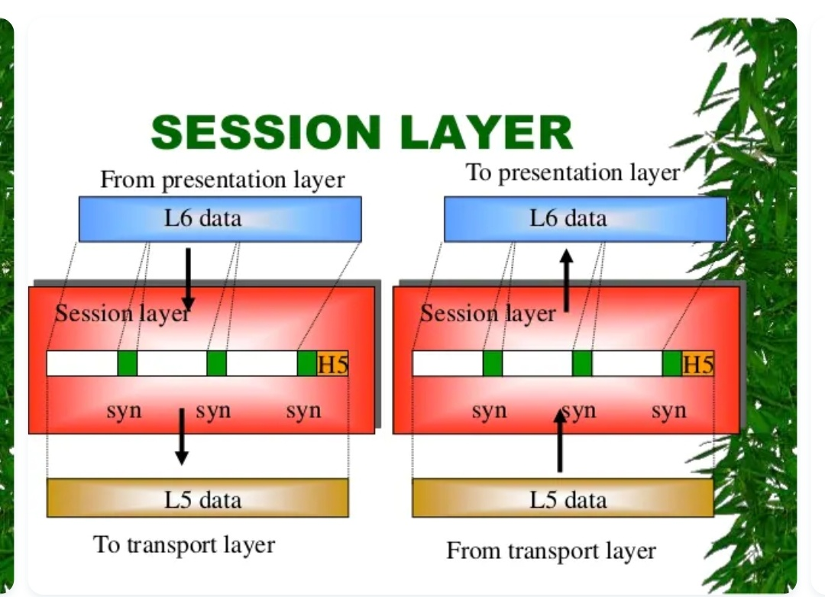
Session layer
This Session layeris the network dialog controller. It established, maintains and synchronizes the interaction between communicating system.
Functions of Session Layer:
Dialog control.
Synchronization.

Slide 48
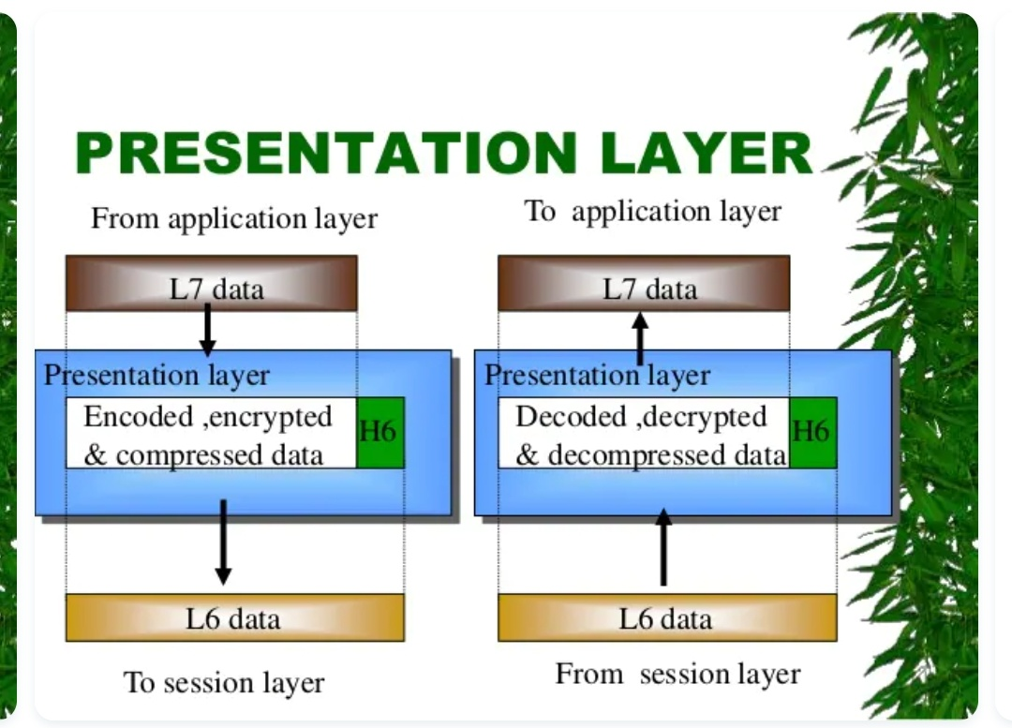
Presentation layer
The presentation layer is concerned with the syntax and semantic of the information exchanged between two system.
Functions of Presentation Layer:
Translation.
Encryption.
Compression (Data compress).

Slide 49
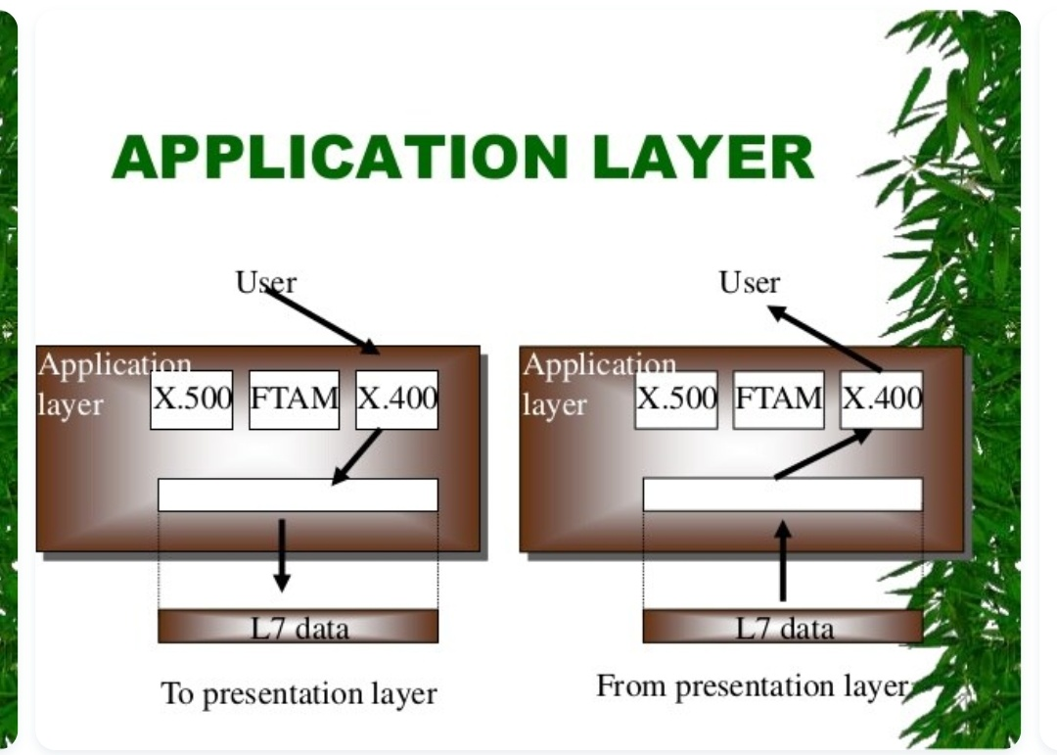
Application layer
The application layer enables the user , whether human or software to access the network. It provides user interfaces and support for services.
Functions of Application layer:
Network virtual terminal.
File transfer access and management(FTAM).

Slide 50
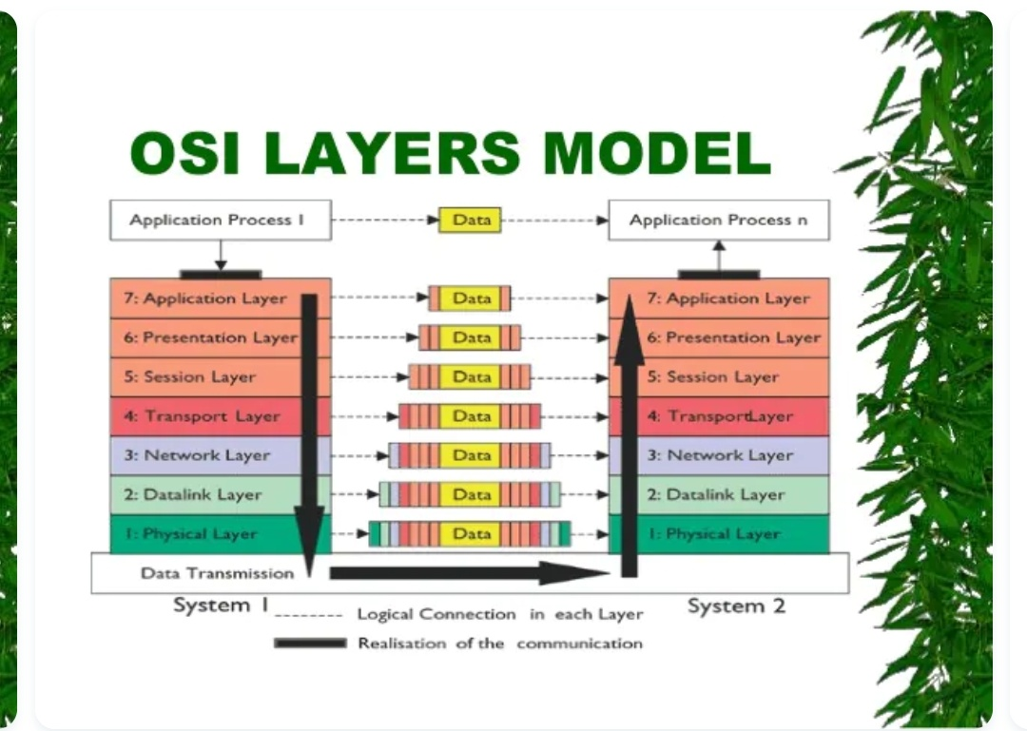

Slide 51
THANK YOU!!

